Slide 1

Hospital management system
Fundamental to programming – II project

Slide 2

Introduction
Hospital management system is very complicated system to build because it has different parts that needs different type of management system. But we tried to cover most parts in our project.

Slide 3

The COVID-19 pandemic has highlighted the need to better digitalize hospitals due to the increased demand for remote healthcare services, efficient patient data management, and improved communication between healthcare providers.‘
This project is our second project as a group. We learned some very essential lessons from our first project and from the courses that we took after.

Slide 4



Problem statement
Minimizing cost
Lack of classification of data
Manual calculating of medicine and lab tests
Classifying data that can be accessed by everyone from data that should only be accessed by employees.
Spending a lot of money for writing materials if we use papers for a documentation system
Being able to calculate the price of a patient’s prescribed medicines or lab tests and preparing the patient for how much they are going to spend.

Slide 5
Process
As soon as we know that our project is hospital management system the first idea that popped up is building a system that accepts the patient’s information by using OOP.
Then we learned managing hospital is more than that so we start adding features such as:-

Slide 6


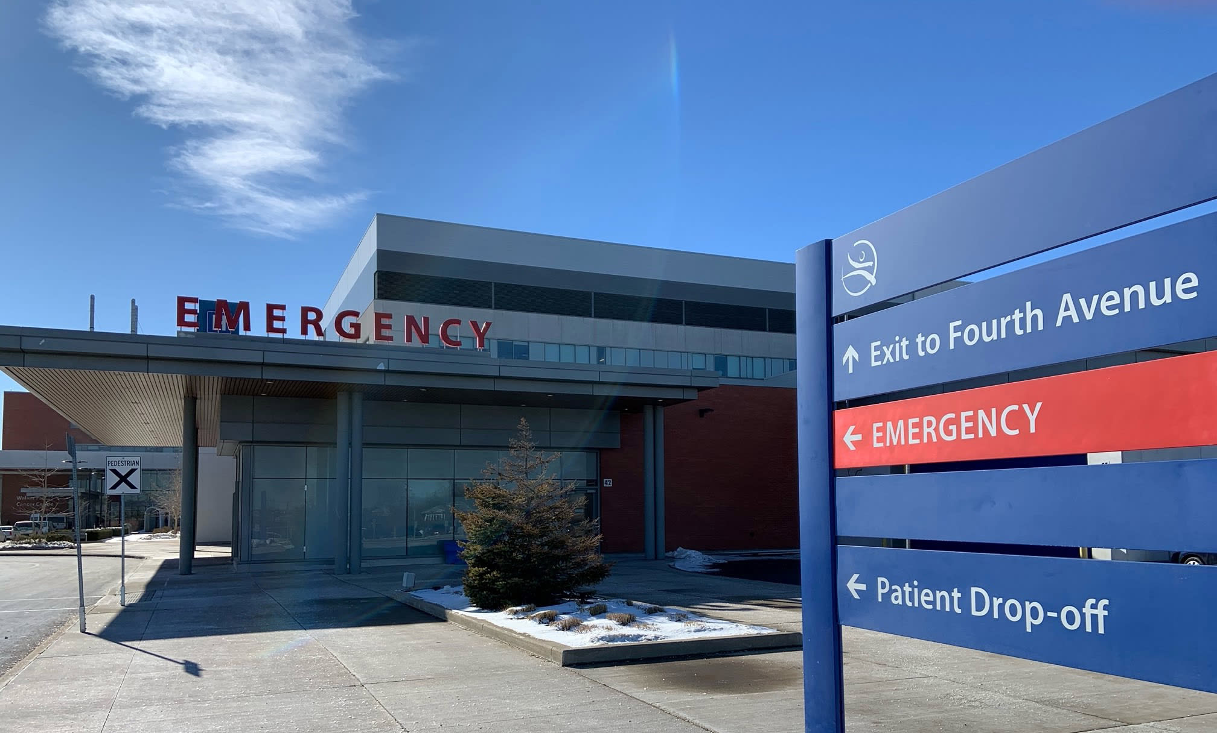
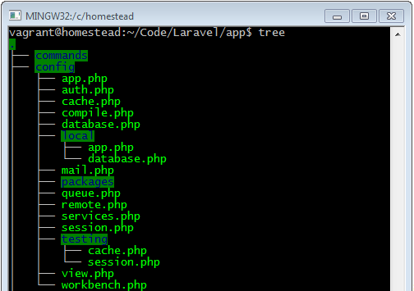
SECURITY
EFFICENCY
TRANSPARNECY
DATABASE
1. Classifying the applications that can be used by everyone and applications that shouldn’t be used by everyone and securing it with password.
2. Allowing patients to choose doctors by accessing doctors’ background.
3. Classifying emergency patients from other patients.
4. Using file system to save information and some other important features which will be explained more next.

Slide 7
solutions
Assuring security of patient information and other information that isn’t allowed to be accessed by everyone.
Minimizing the cost that will be spending on paper by substituting most paper documentation system by computerized system.
Calculating the price of lab tests and medicine and informing the patient and etc.

Slide 8

pseudocode

Slide 9
Start the program.
Display a menu with options (“Employee”, “Patient”, “Emergency”) for the user to choose from.
Ask the user to enter their choice (ask1).
If ask1 = 1,
Ask the user to enter a passcode, if passcode is correct
Ask the user to choose patNum (“Add a patient”,“Access patient info”,“Medical inventory”).
If patNum = 1,
Take patient info.
Then take the info to the patients.cpp file that has a class.
Save it to the text file (“patients.txt”).
Go to step 3.
If patNum = 2,
Print patient info on the console from (“Patients.txt”).
Go to step 3.

Slide 10
If patNum = 3,
Ask the user to choose patNum (“Add lab equipment”, “Access lab equipment info”).
If patNum = 1,
Take equipment info.
Then take the info to the equipments.cpp file that has a class.
Save the info to the text file (“Equipments.txt”).
Go to step 3.
If patNum = 2,
Print equipment info to the console from (“Equipments.txt”).
Go to step 3.
Else if the passcode is not correct.
Print wrong passcode!!
Go to step 4.1.

Slide 11
5. If ask1 = 2,
Display a menu with options for the user to choose from (“Access some doctors info”, “Calculate medicine price”, “calculate medical lab test price”, “continue”).
If ask2 = 1,
Print some doctors info on the console from (“Employee.txt”).
Go to step 3.
If ask2 = 2,
Print the medicines that are available, and calculate their prices as the user enters their number.
Print the price on the console
Go to step 3.
If ask2 = 3,
Print the lab tests that are available, and calculate their prices as the user enters their number.
Print the price on the console
Go to step 3.

Slide 12
If ask2 = 4,
Ask which body part hurts.
Ask the level of pain.
If pain < 5, assign a nurse and pain > 5 assign a doctor.
Take patients info and ticket price.
Then take the info to the patients.cpp file that has a class.
Print the patients info with assigned nurse/doctor.
Go to step 3.
6. If ask1 = 3,
Ask the user to choose patNum (“Add an emergency patient”, “Access emergency patient info”)
If patNum = 1,
Print the number of patients available by counting the number of lines in the text file and divide it by 6.
If the number of patients is greater than or equal to 10.
Print Emergency beds are full.
Go to step 3.

Slide 13
If the number of patients is less than 10
Take patients info.
Then take the info to the patients.cpp file that has a class.
Print the patients info with assigned nurse/doctor.
Save the info to the text file (“EMERGENCY.txt”).
Go to step 3.
If patNum = 2,
Print patient info to the console from (“EMERGENCY.txt”).
Go to step 3.
7. If ask1 = 0,
End the program.

Slide 14
Conclusion
In conclusion, implementing this hospital management system will prove to be a crucial step towards enhancing the efficiency and effectiveness of healthcare services.
By integrating various departments, streamlining administrative tasks, and improving communication and data management, this system has revolutionized the way hospitals operate.

Slide 15

Thankyou!!

